Slide 1
CloudWalk Logistics case
Rodrigo Shoiti Simões

Slide 2
Main given information
► Creation date
► In transit to Local Distribution
► At Local Distribution
► In transit to Delivered
► Delivered
► Estimated Delivery Date

Slide 3
Processed data
► Days to arrive at Local Distribution (from Creation Date)
► Days to be Delivered (from arrival at Local Distribution)
► Real Time (total from Creation Date until Delivered)
► Estimated Time (total from Creation Date until Estimated Date)
► Difference between Real and Estimated Time

Slide 4
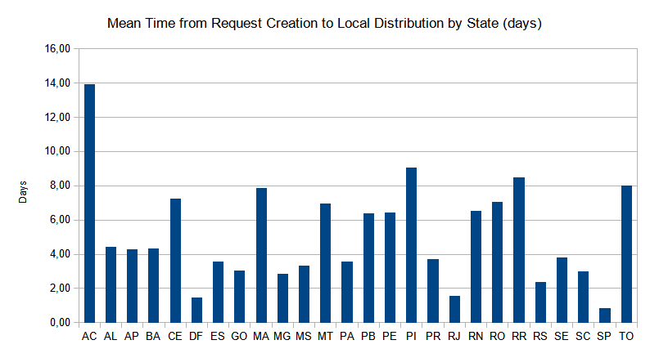
Time to Local Distribution

Slide 5
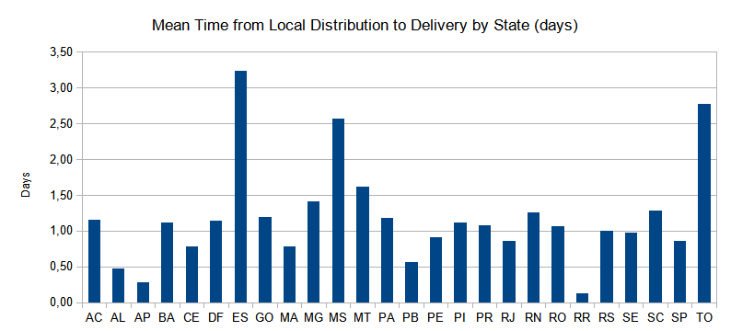
Time to Delivered

Slide 6
First impressions
► Large variations until arrival at Local Distribution
►Probably accessibility
► Local Distribution is not the main issue
► “Yellow Flags”: ES, MS and TO
► Outliers: Espírito Santo, 3.24 days average

Slide 7
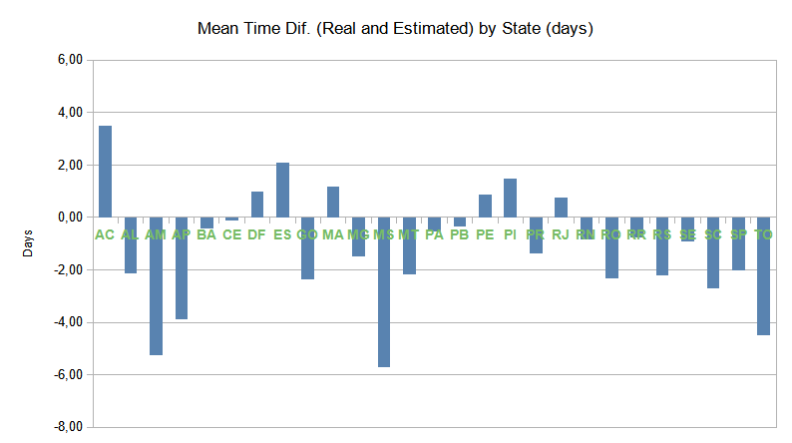
Difference - Real and Estimated Delivery Time

Slide 8
First impressions
► 7 states have a delay in the Estimated Delivery Time
►AC, DF, ES, MA, PE, PI and RJ
► Deliveries to each state
► 76, 720, 653, 622, 1262, 447 and 663, respectively
►Total cases: 34430

Slide 9
First conclusions
► Few problems with local distribution, 3 main states to look into
► 1 of which with delay in the Estimated Delivery Time
► Few states with late delivery problem
► 13% of total, most with less than 2 days of variation from prediction

Slide 10
Crossing information
► Only Espírito Santo has a big delivery time problem
► Best bet for a fast gain project
► Days to arrive at Local Distribution should be standardized by state
► Low deviation expected on acceptable delivery time cases
► AC has average delivery time of 1.16 day
► AC has Real vs Estimated time difference of 3.50 days

Slide 11
Possible Problems
► Poor understanding of the “sending the product to the local distribution” process
► Should not be influencing the delay in the expected date
► Bad defined standards on process
► Mean masking excessive variation in values, both above and bellow

Slide 12
Next Steps
► Check if previously mentioned problems are actually occurring
► Boxplot analysis of deviations within each state
► More data to compare patterns
► Analysis with real world changes/problems taken into account

